Slide 1






Big Data analysis
Speaker: Sun Chunhui

Slide 2
The big data analysis Background introduction
IRONWASTE
THE FIRST CHARPTER

Slide 3




· In recent years, the development of big data models more and more rapidly, and everyone enjoy the benefits of it.
Deepseek can solve our problem by word.
Sora can generate some specific videos to meet the people’s needs.
· But most people don’t know the role of big data analysis in it.
IRONWASTE
THE FIRST CHARPTER

Slide 4
What is
the big data analysis
IRONWASTE
THE SECOND CHARPTER

Slide 5

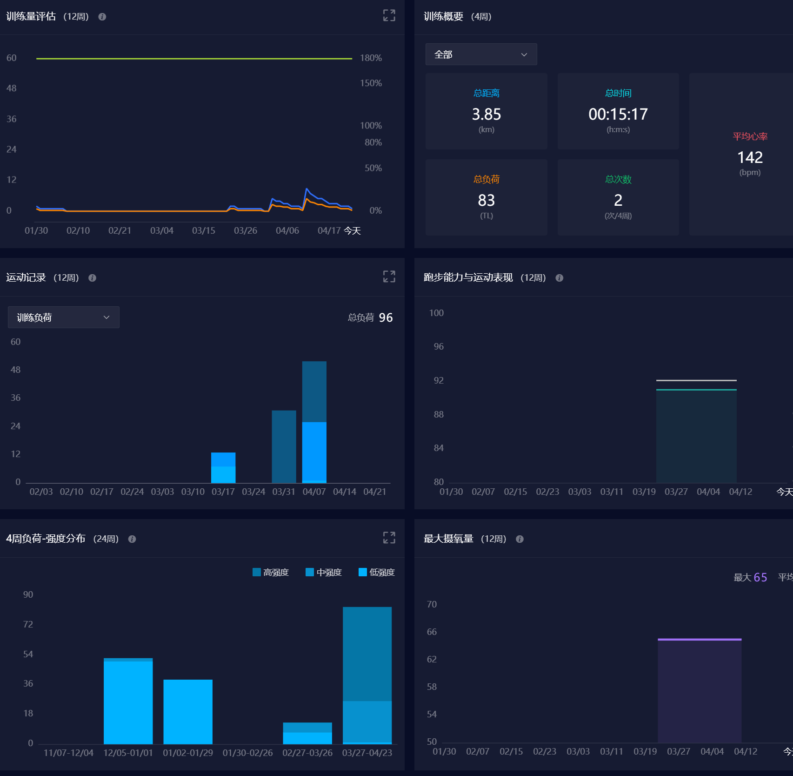

“Data is woven into the everyday fabric of our lives. With the rise of mobile, social media, and so on, we now transmit more data than ever before—and at a dizzying speed.
"Big data analytics describes the process of uncovering trends, patterns, and correlations in large amounts of raw data to help make data-informed decisions. These processes use familiar statistical analysis techniques—like clustering and regression—and apply them to more extensive datasets with the help of newer tools. "
IRONWASTE
THE SECOND CHARPTER

Slide 6
History of
big data analysis
IRONWASTE
THE THIRD CHARPTER

Slide 7
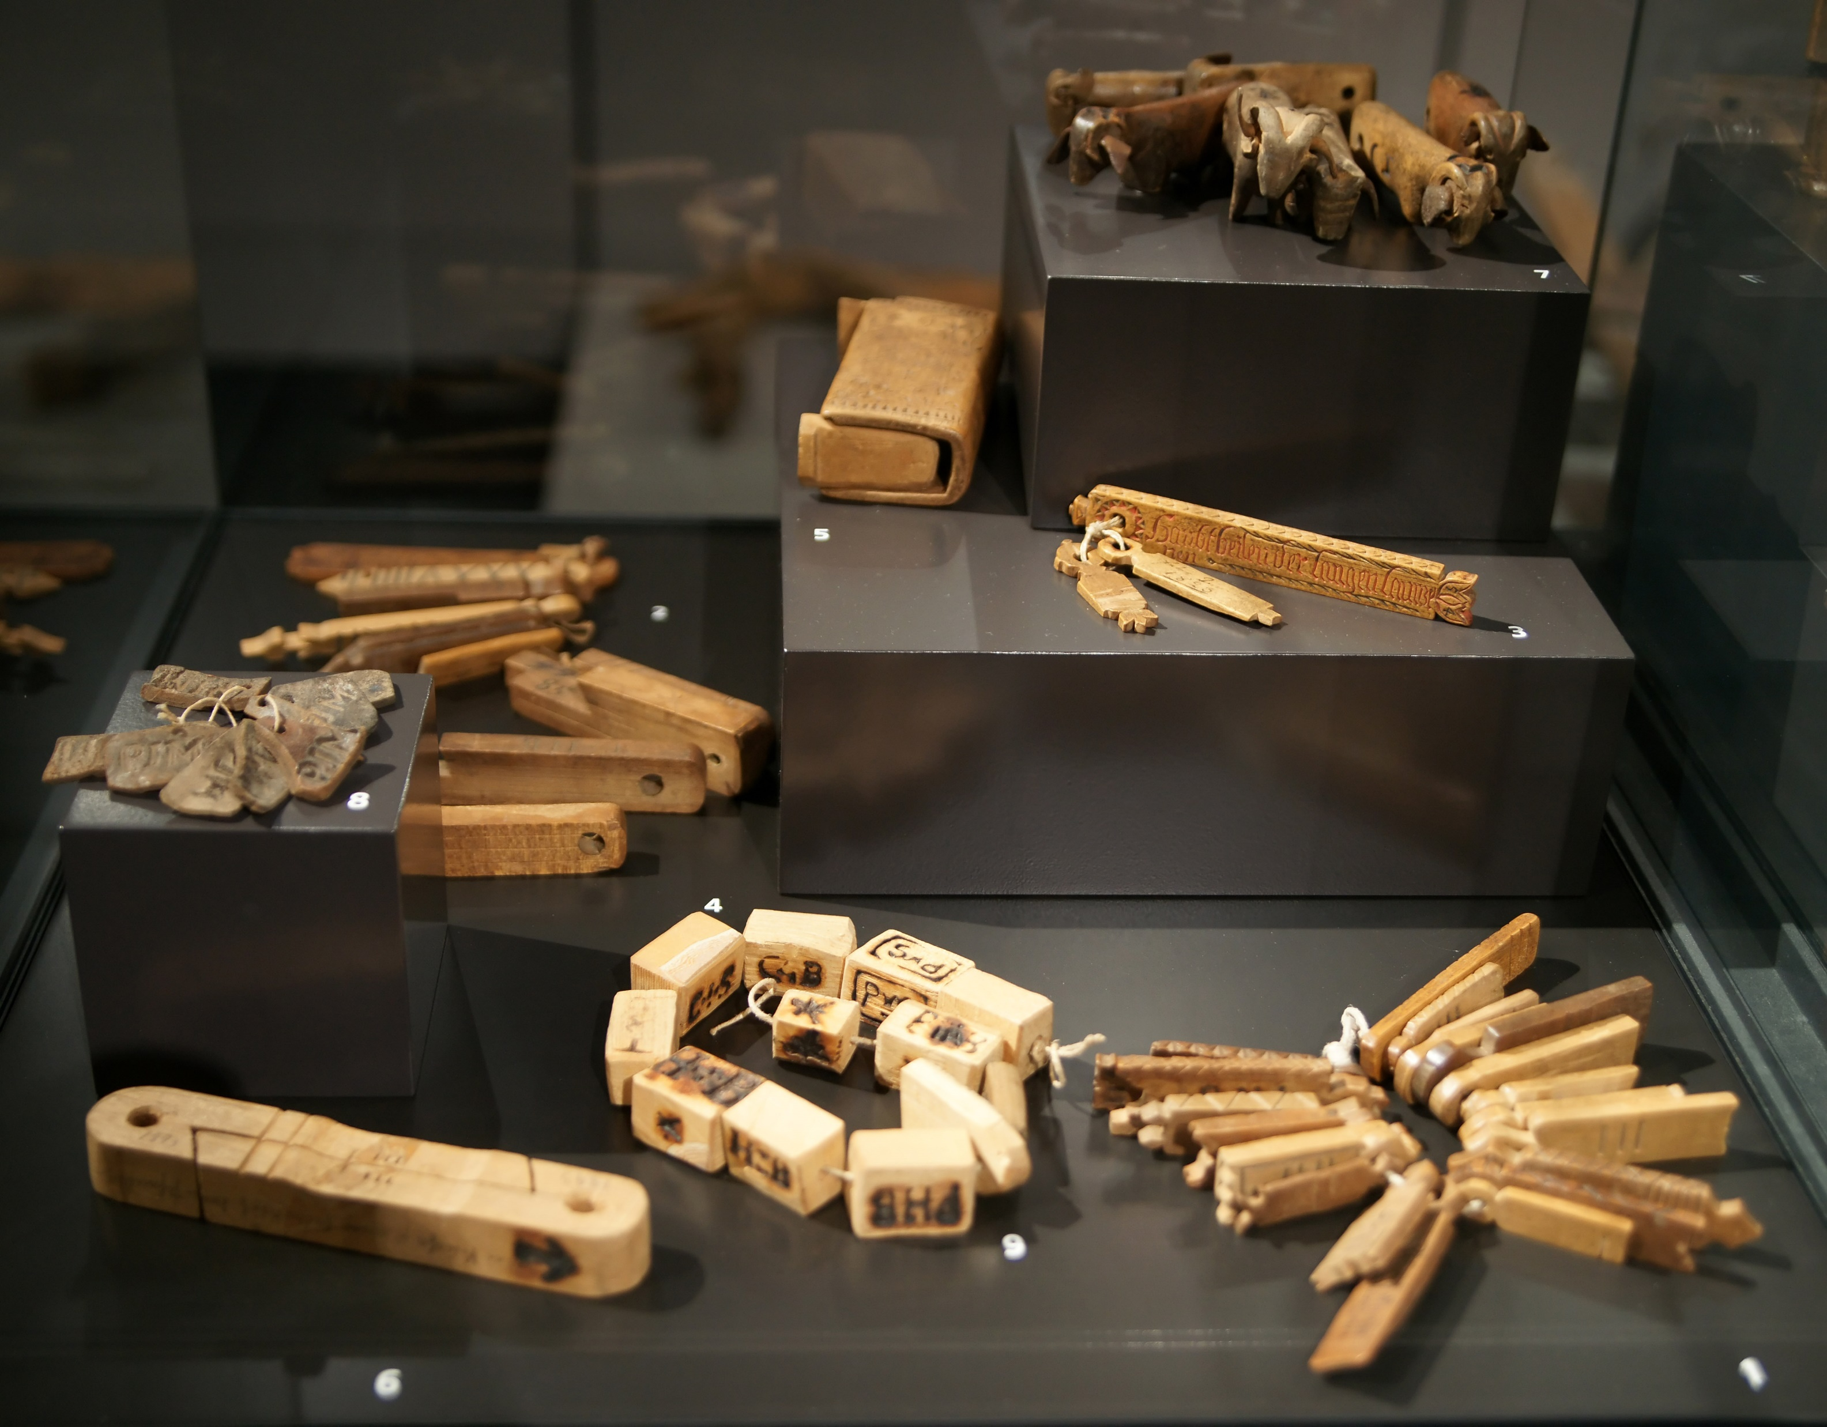
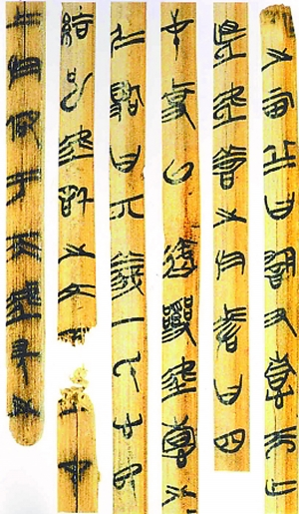
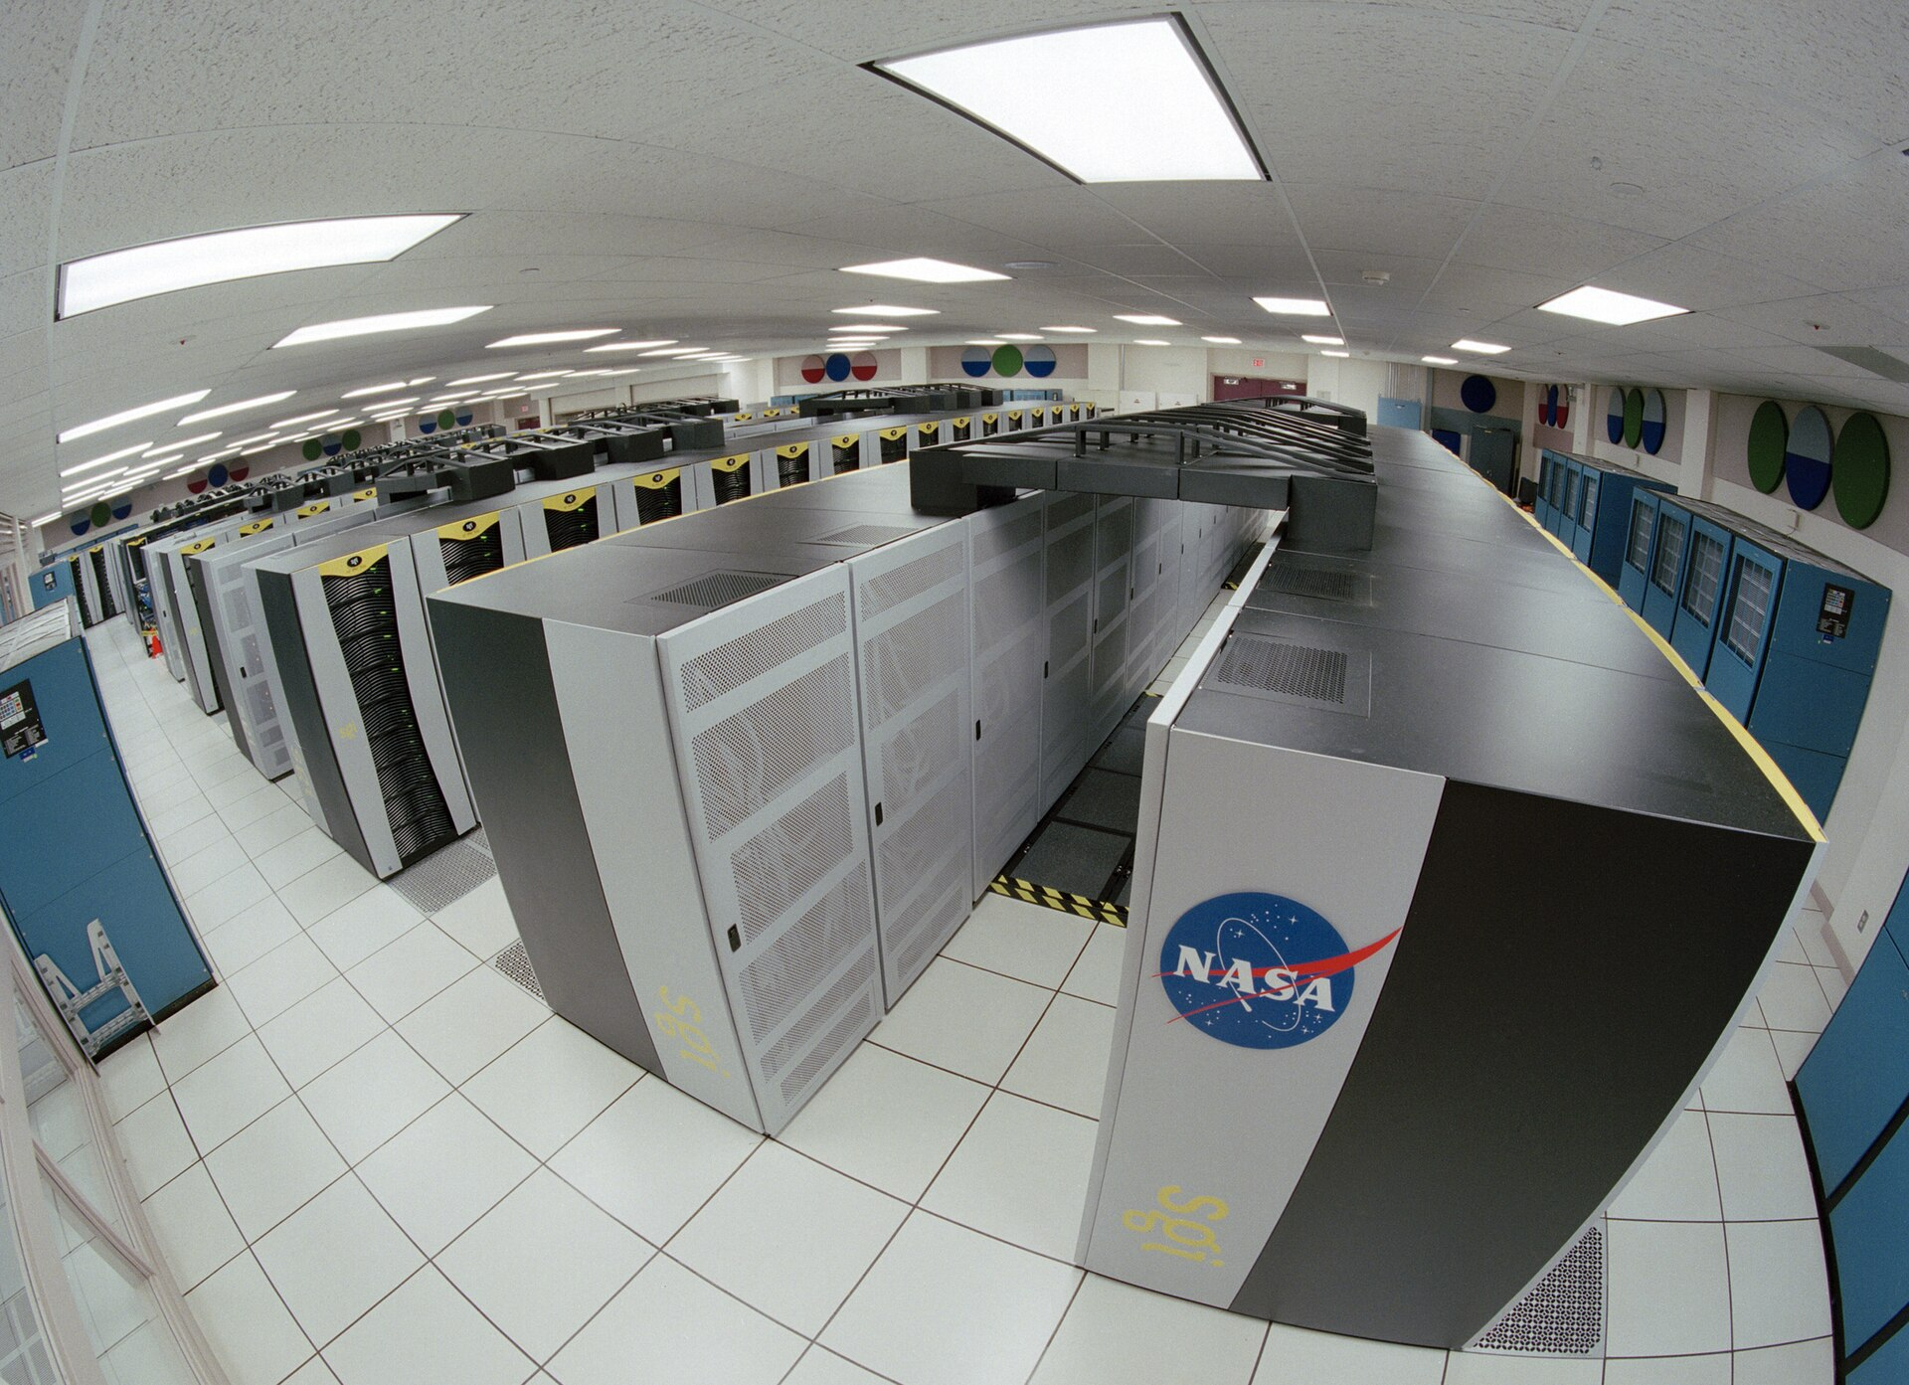
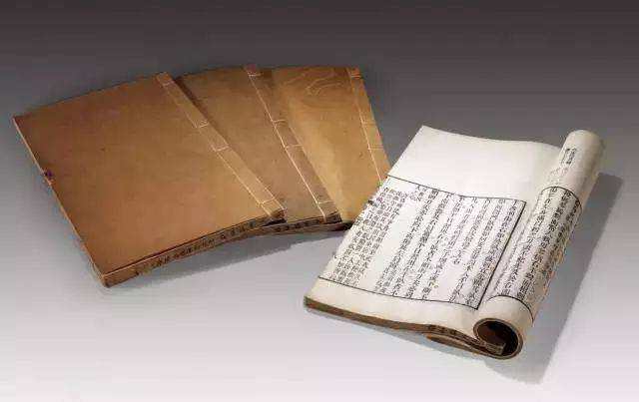
Most people think that big data analytics should be a technology that has emerged in last few decades, but it’s really not. The earliest examples we have od humans storing and analyzing data are the tally sticks, which date back to 18,000 BCE!
With the evolution of storage media, we creating various of methods about to analysis the data and extract useful information from the big datas.
IRONWASTE
THE THIRD CHARPTER

Slide 8
big data analysis
IN CHINA
IRONWASTE
THE FOUR CHARPTER

Slide 9
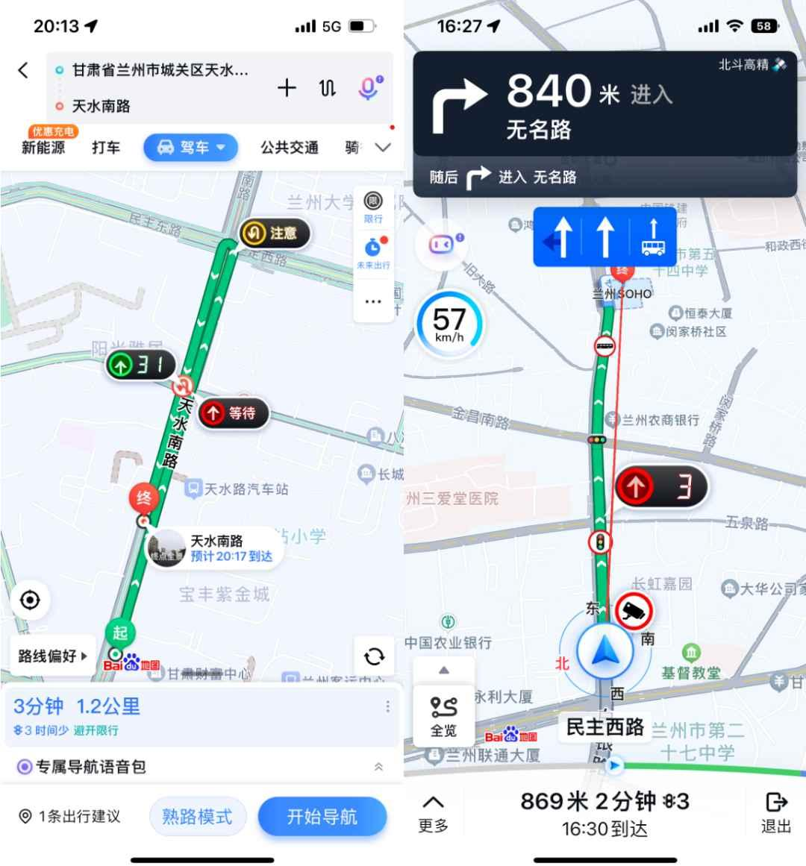

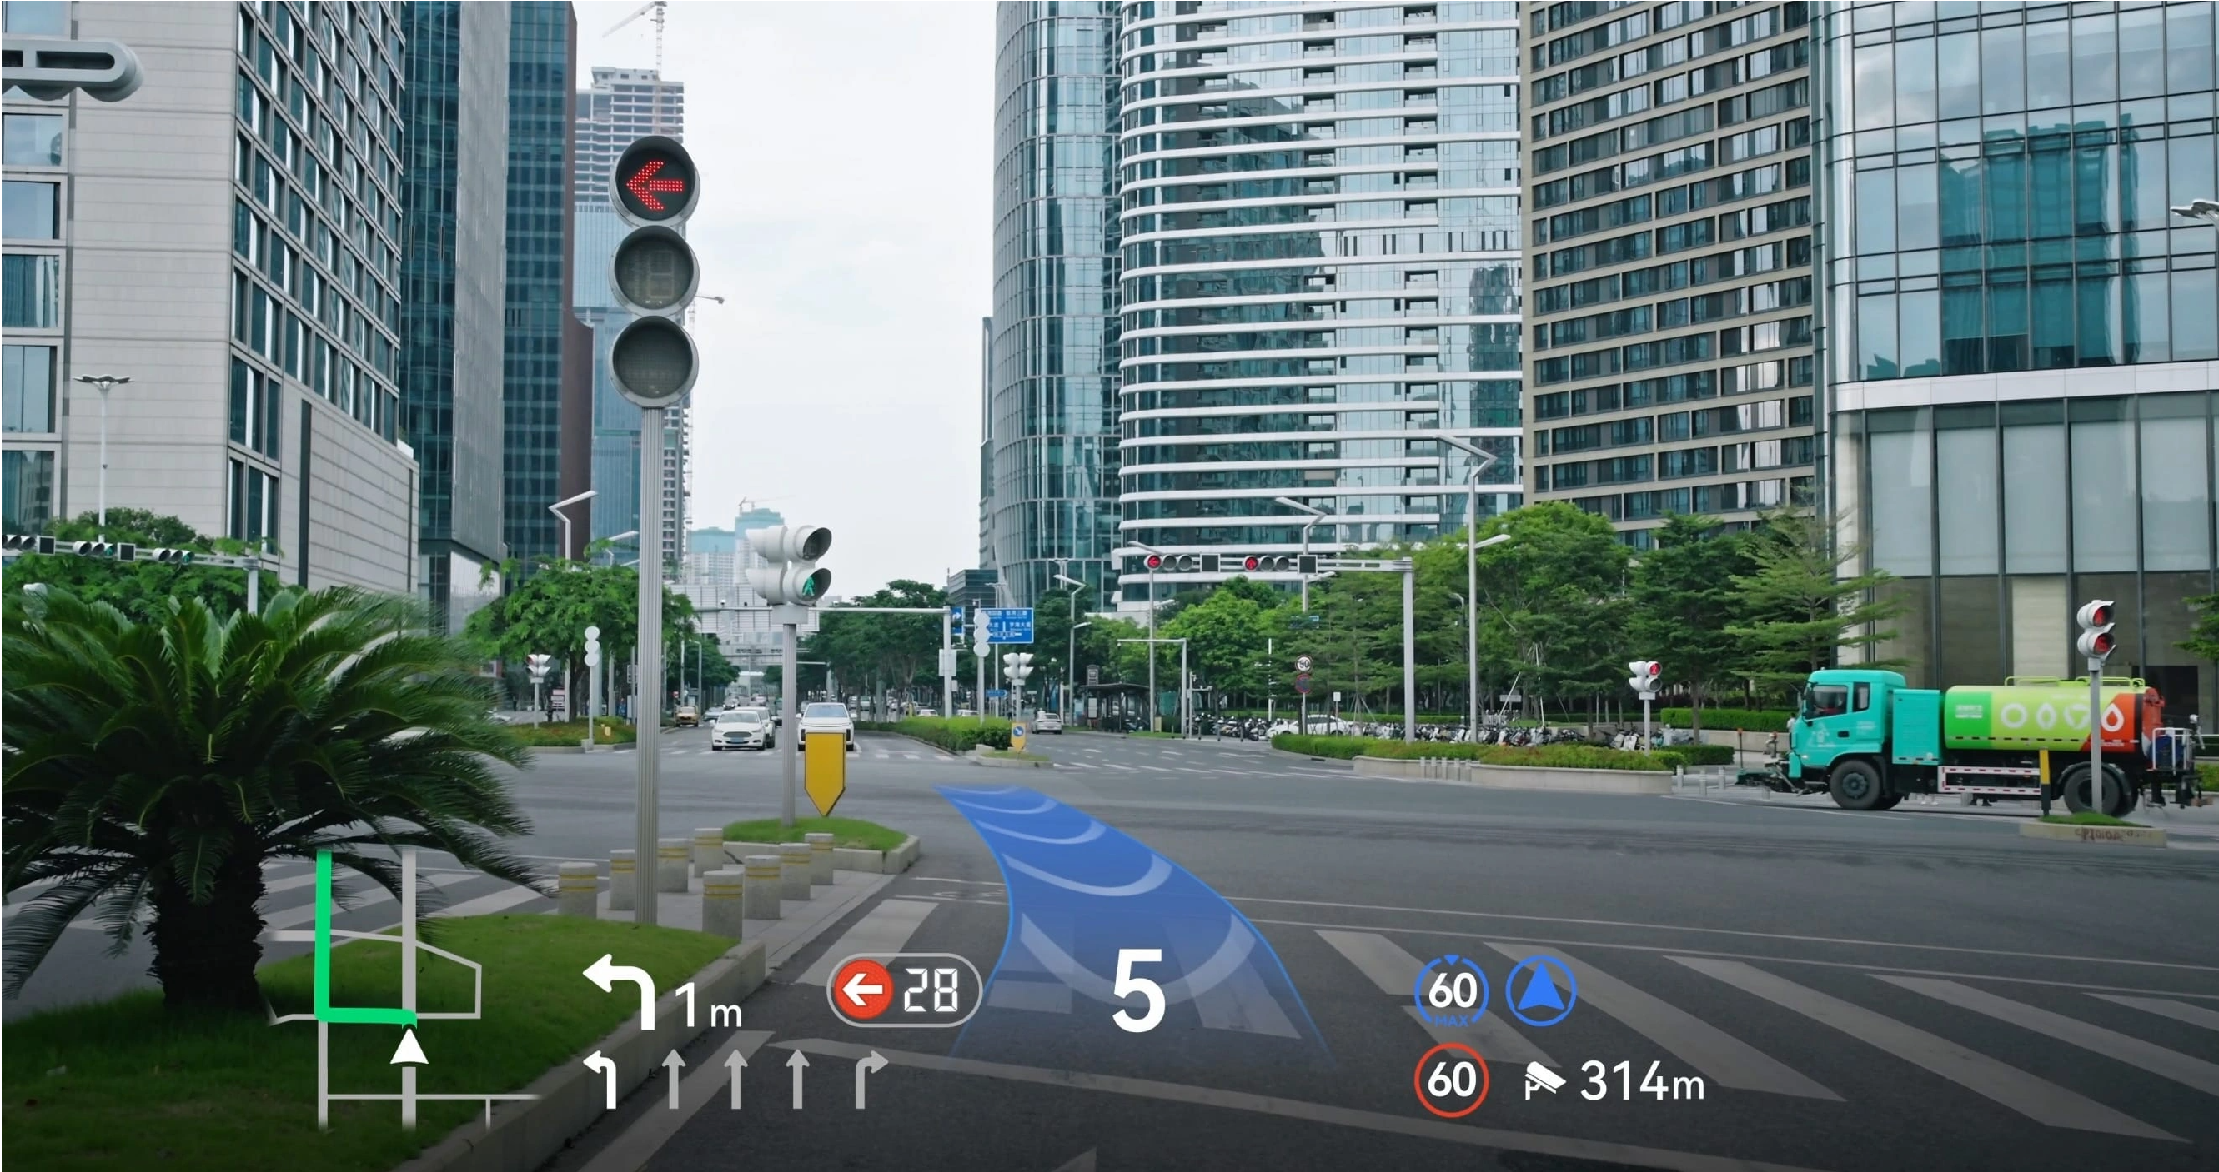
The traffic prediction is more correct than before with the addition of big data analysis technology. This applied to autonomous driving for realize the optimal path planning that will reduce traffic congression and provide us with the best options to quickly reach our destination.
During the use of Harmony Intelligent Mobility Alliance, we release some attention in traffic and keep our nerves from tightening. It is a useful things for novice drivers who can enjoy the fun of driving without being bothered by other things.
IRONWASTE
THE FOUR CHARPTER

Slide 10
big data analysis
IN FUTURE
IRONWASTE
THE FIFTH CHARPTER

Slide 11
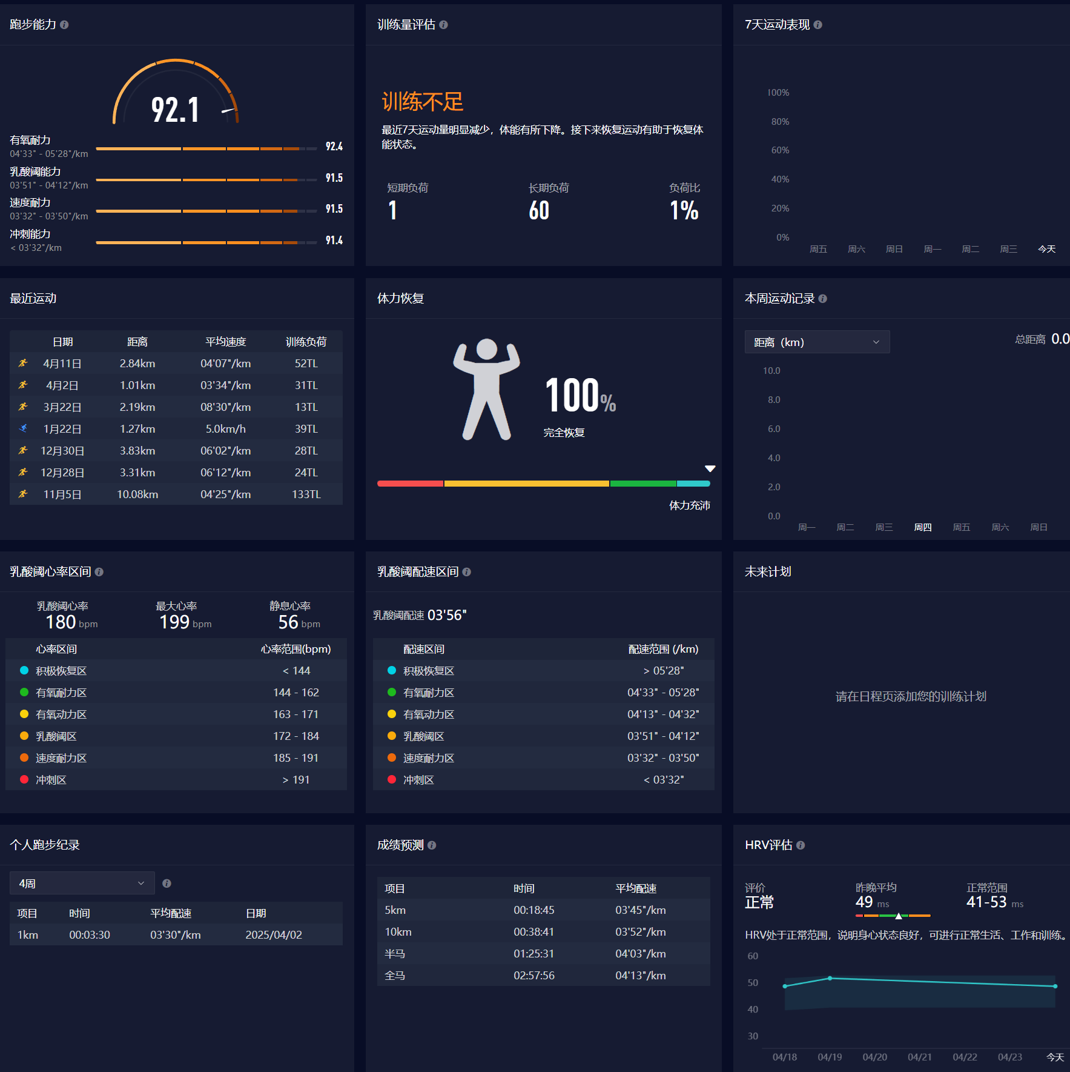
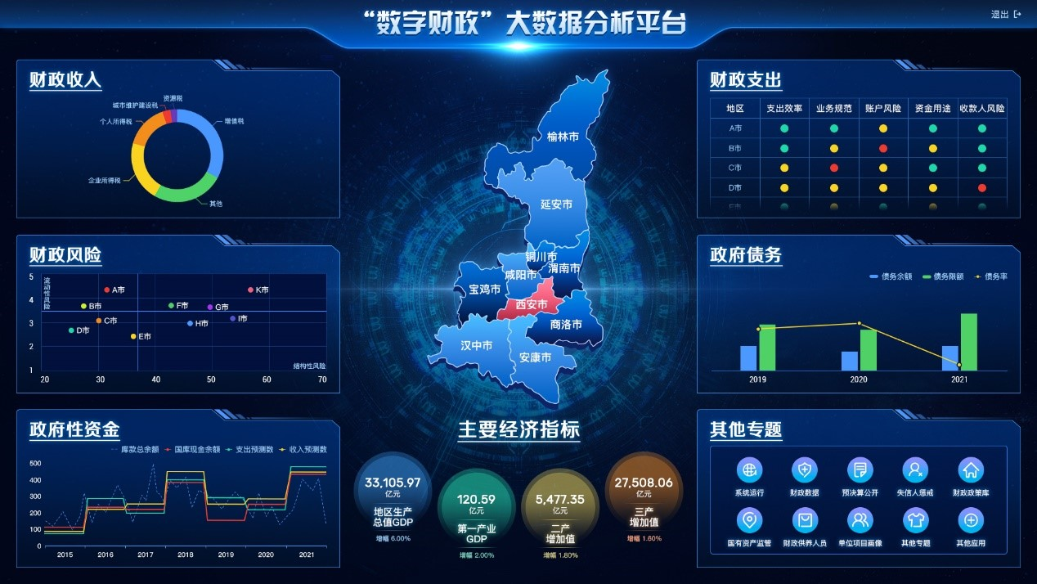
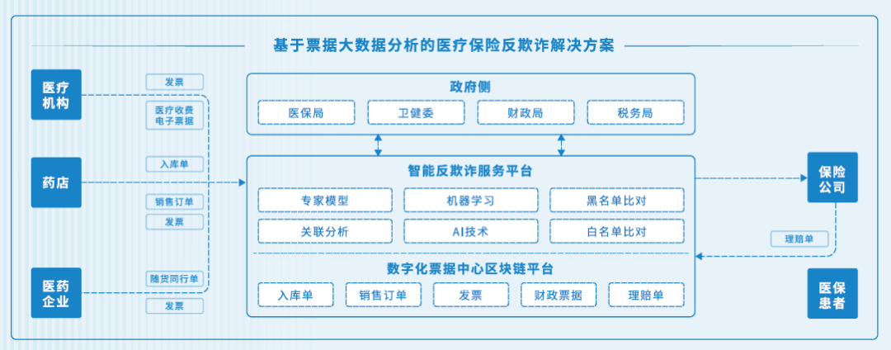
In the future, big data analytics will penetrate every aspect of our lives such as health training, medical care ,financial services and so no.
But supervision and prevention of big data and data privacy is a major issue that needs to be solved in the future.
IRONWASTE
THE FIFTH CHARPTER

Slide 12
THANKS!

